Slide 1

Generating Image Captions based on Deep Learning and Natural language Processing
by
M. Bhargavi
Roll No. 204G1A0521
G. Jasmin
Roll No. 204G1A0542
P. Manjusha
Roll No. 204G1A0552
A. Anulekha Sai
Roll No. 214G5A0504
Under the guidance of
Mrs. P. Rohini M. Tech
Assistant Professor
Department of Computer Science and Engineering
Srinivasa Ramanujan Institute of Technology
(Autonomous)
2023 - 2024

Slide 2

Contents
Review-0 Comments
Abstract
Problem statement
Objectives of Project
Literature survey for first objective
Objective-1(Design & Implementation
Literature survey for second objective
Objective-2 (Design & Implementation)
Proposed Work -(Methods to be followed for proposed system)
References
GitHub Link

Slide 3
Review-0 Comments
To implement new proposed functionality.
Should have idea on literature survey.

Slide 4
Review-1 Comments
Focus on Implementation.
Need to get an idea on preprocessing techniques.
Study about LSTM algorithm in depth.

Slide 5
Abstract
In today's digital world Image Captioning system connects visual content and human language, this significant project explores the dynamic convergence of Deep Learning and Natural Language Processing (NLP) for improving human-computer interactions, information retrieval, and accessibility.
The project starts by gathering a substantial dataset of image-description pairs. This dataset serves as the basis for developing and testing the proposed image captioning model. Recurrent Neural Networks (RNNs), including LSTM and Transformer-based models, generate coherent, contextually relevant captions, while Deep Convolutional Neural Networks (CNNs) extract features from images effectively.

Slide 6
Problem Statement
The primary problem addressed by this project is the inadequacy of existing image captioning systems in producing comprehensive and accurate captions.
The existing image captioning systems face challenges in generating accurate and contextually relevant descriptions, often resulting in inadequate or inaccurate captions.
The main problem addressed by this project is the development of an innovative system to produce comprehensive and precise image captions by exploiting both global and specific image features.

Slide 7
Objectives of Project
Research Objective 1: To Develop a deep learning-based image captioning model that surpasses the current state-of-the-art performance in terms of captioning accuracy through train the dataset model efficiently.
Research Objective 2: The project is designed to convert the generated image caption into audio by using machine learning techniques.

Slide 8
Literature survey for first objective
[1]. In this paper, Sound recommendation is done by associating recognized image scenes with relevant sounds from a database, enhancing the user's perception of the image by providing an auditory context that matches the visual content.
[2]. In this paper, A photo is provided to the CNN analyzes and produce a feature vector that is quite dense. This embedding (feature vector) can be used as an input by numerous accessible functions that will provide an image description. It will act as the Long Short Term Memory (LSTM) initial state, which will aid in determining a suitable caption for the entered image.

Slide 9
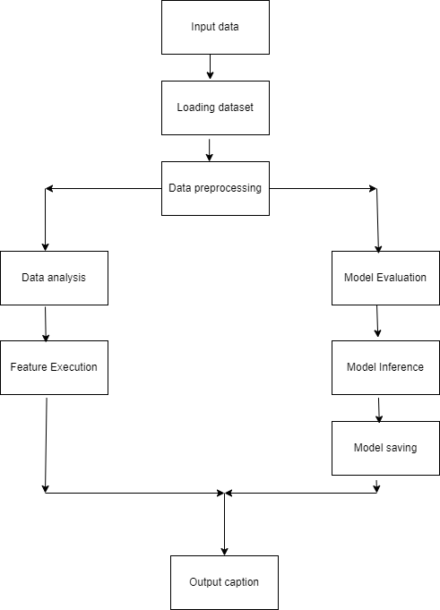
Design and Implementation for first objective
Fig 1 : Architecture

Slide 10
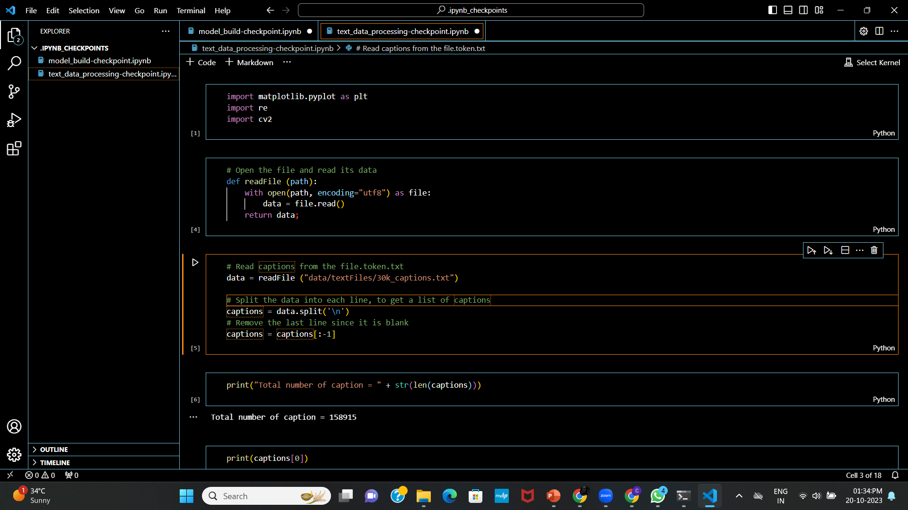
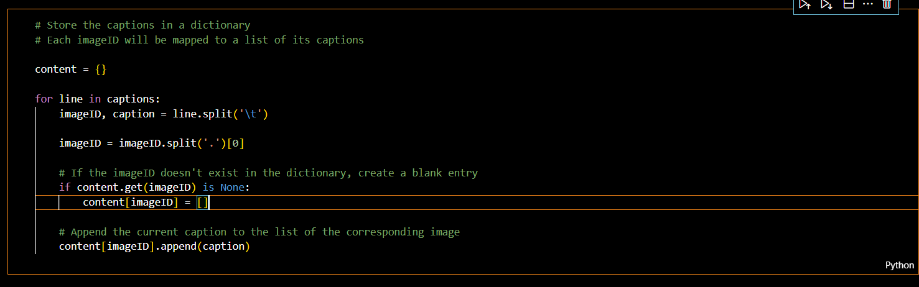
Design and Implementation for first objective
Text data processing

Slide 11
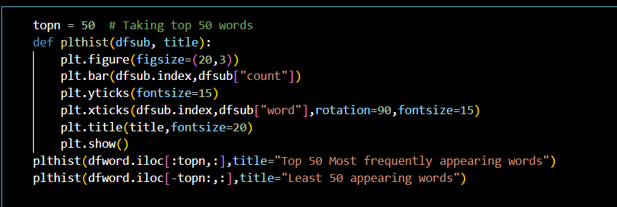
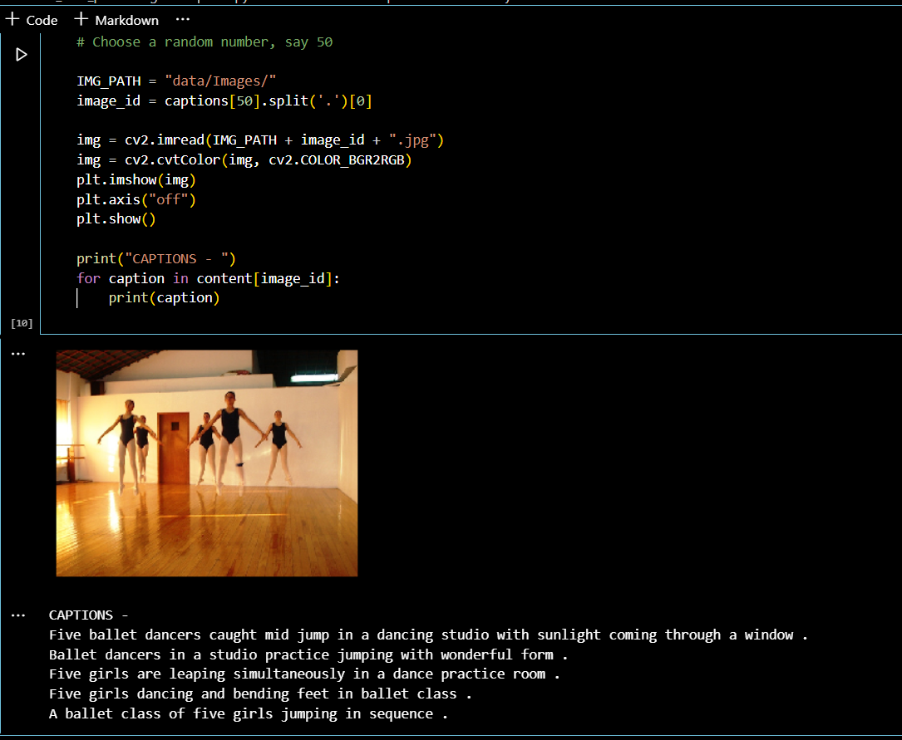
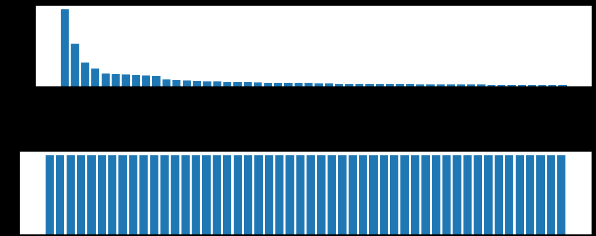
Design and Implementation for first objective
Text and image data processing
Checking captions have mapped correctly

Slide 12
Literature survey for second objective
[3]. The proposed system for the project “Design and implementation of text to speech conversion for visually impaired people" is a sophisticated and versatile solution that developed a useful text-to-speech synthesizer in the form of a simple application that converts inputted text into synthesized speech and reads out to the user.
[4]. The project specifies the use of the Flickr8k dataset for training and testing which is significantly good. The BLEU score is used as an evaluation metric to assess the quality of generated captions.

Slide 13
Design and implementation of second objective
The generated textual captions into spoken audio using a Text-to-Speech (TTS) system. TTS systems take text input and produce corresponding speech output. These systems can vary in complexity, from simple rule-based systems to more sophisticated deep learning-based models.
Use a model (e.g., a deep learning-based image captioning model) to generate textual descriptions or captions for input images. Take the generated textual captions and input them into a TTS system. The TTS system synthesizes the text into spoken audio.

Slide 14
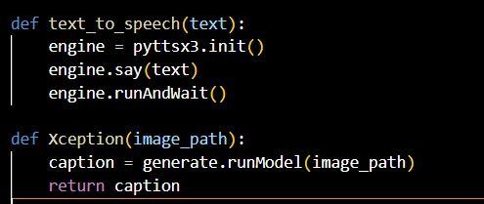
Design and implementation of second objective
The Xception function seems to use a model called Xception to generate a caption for an image specified by the image_path
The actual implementation of the generate,
runModel method and the underlying model
details would determine how the caption is
generated.
The text_to_speech function appears to use the
pyttsx3 library to initialize a text-to-speech
engine, say the provided text, and then run the
engine to play the speech.
Then the caption will be displayed along with
voice.

Slide 15
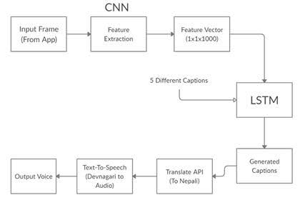
Design and implementation of second objective
Block Diagram

Slide 16
Proposed System
The proposed system for the project "Generating Image Captions based on Deep Learning and Natural language Processing" is a sophisticated and versatile image captioning solution that seamlessly integrates deep learning techniques and NLP to generate accurate, contextually relevant, and linguistically coherent captions for images along with appropriate sounds.
A image is provided to the CNN analyzes and produce a feature vector. This feature vector is used as input for sigmoid functions and ReLU functions in the GRU and LSTM and provide image descriptions and are associated with relevant sounds for the image thereby enhancing the user's perception of the image by providing an auditory context that matches the visual content.

Slide 17
References
[1].M. Poongodi, Mounir Hamdi, Huihui wang, “Image and audio caps: automated captioning of background sounds and images using deep learning”, ResearchGate, vol. 83, pp. 17118-17125, Feb 2022.
[2]. Chaithra V1, Charitra Rao2, Deeksha K3 , Shreya4, Dr.Jagadisha N5 “IMAGE CAPTION GENERATOR USING DEEP LEARNING”, International Research Journal of Engineering and Technology, vol.09, pp.933-937, Nov 2021.
[3]. Itunuoluwa Isewon, Jelili Oyelade, Olufunke Oladipupo, “Design and implementation of text to speech conversion for visually impaired people”, IJAIS, Volume 7– No. 2, ISSN : 2249-0868, 2023.
[4]. Dr. Savita Sangam, Abhijeet Sawant, Abhishek Malap, Deepak Yadav, “Automated Image Captioning Using Deep Learning”, International Research Journal of Engineering and Technology, vol.07, pp.7310-7312, May 2020.

Slide 18
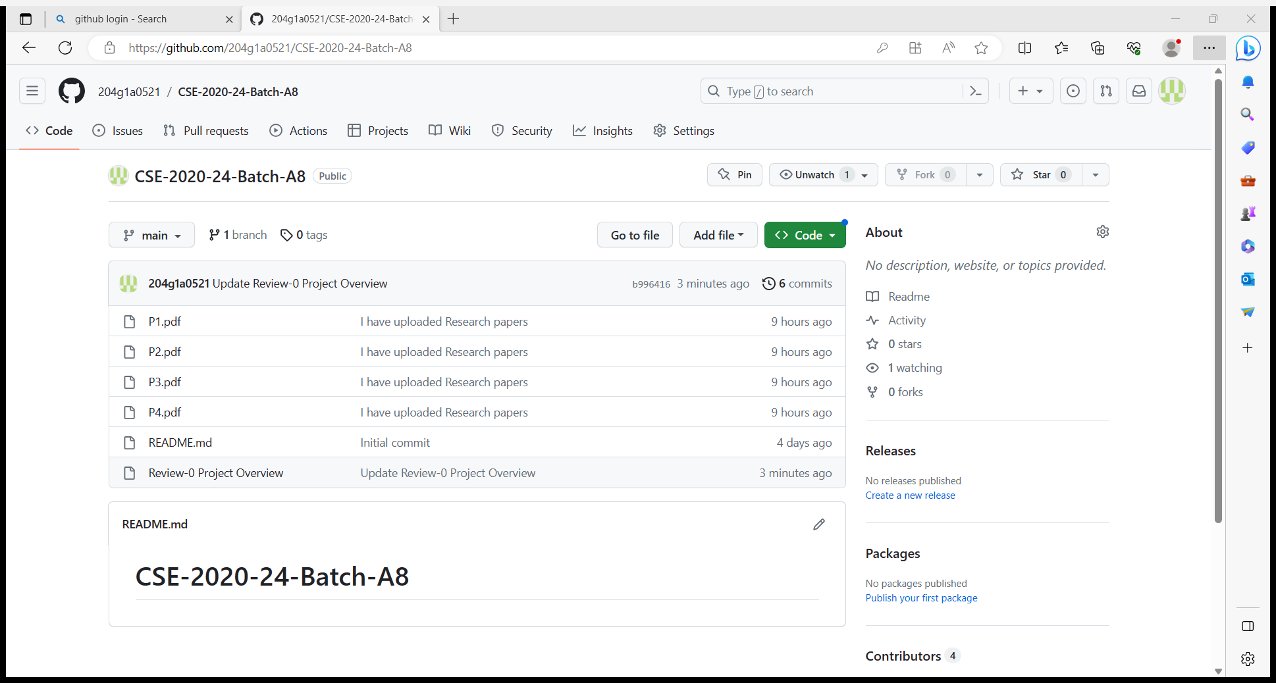
Git Hub Dashboard

Slide 19
Any Queries?

